Slide 1
The Air Force Should Not Recruit Only Officers with Science, Technology, Engineering, and Mathematics （STEM）Degrees
Wei Cui, Cadet Capt, USAF
Notes:
Good morning Capt Morse Good morning Gentlemen.
Im cadet cui and today I am going to brief you on the topic that The Air Force Should Not Recruit Only Officers with Science, Technology, Engineering, and Mathematics degrees, also know as STEM Degrees

Slide 2
overview
Eligibility
Needs of the Air Force
Soft Skills
Notes:
I will talk about why the air force should not only recruit officers with STEM degrees. Officers with STEM degrees are not qualified for some career fields which require a license or a background in in the medical or legal or chaplaincy fields
One may argue that due to growing needs of the Air Force, STEM degrees are highly sought, but I will lay out the fact that the soft skills are important for officers, recruiting only officers with STEM degrees will turn away many great officers with non-STEM degrees.
// additional comments
Officers with STEM degrees are not qualified for the career fields that require special skills and professional degrees such as Doctor of Medicine (MD) and Doctor of Law Degree (JD). Although STEM degrees are valued in some non-STEM required career fields, recruiting only officers with STEM degrees will turn away many great officers with non-STEM degrees.

Slide 3
overview
Eligibility
Needs of the Air Force
Soft Skills
Notes:
// additional comments
The Air Force should not recruit only officers with science, technology, engineering, and math (STEM) degrees. Officers with STEM degrees are not qualified for the career fields that require special skills and professional degrees such as Doctor of Medicine (MD) and Doctor of Law Degree (JD). Although STEM degrees are valued in some non-STEM required career fields, recruiting only officers with STEM degrees will turn away many great officers with non-STEM degrees.

Slide 4
eligibility
There are over 200 degrees belong to STEM.¹
There are only five out of 26 Air Force Specialty Codes (AFSCs) require a STEM degree.²
Figure 1. STEM and Non-STEM Required in AFSC
Notes:
STEM is an acronym for Science, Technology, Engineering, and Mathematics.
According to STEM Designated Degree Program List from U.S. Immigration and Customs Enforcement,, there are over 200 academic degrees on the list.
According to Air Force Studies Board, Examination of the U.S. Air Force’s Science, Technology, Engineering, and Mathematics (STEM) Workforce Needs in the Future and Its Strategy to Meet Those Need. There are 26 officer career fields that are identified by Air Force Specialty Codes (AFSCs). However, only five career fields require a STEM degree.

Slide 5
eligibility
Some career fields require a license or experience in the nursing or chaplaincy fields.³
STEM degrees are not qualified for the career fields that require professional degrees such as Doctor of Medicine (MD) or Doctor of Law (JD).⁴
Notes:
Some career fields require a current license or experience in nursing or chaplaincy fields. For example nurses, chaplains.
And some career fields require professional degrees.⁴ such as Doctor of Medicine (MD) and Doctor of Law Degree (JD) and require multi year of training.²
Officers with STEM degrees are not qualified for these fields.
Therefore, the Air Force must recruit officer with various background to fit different career fields
// additional comments
a healthcare, legal or ministry professional (https://www.airforce.com/education/military-training/cot)

Slide 6
overview
Eligibility
Needs of the Air Force
Soft Skills

Slide 7
Needs of the Air force
The officers with STEM degrees are valued in the non-STEM required career fields.⁵
STEM graduates have some skills such as analytical thinking and problem solving are essential to perform duties in non-STEM required career fields.⁶
Notes:
One may argue that there are no stated requirements for degrees in some career fields, such as intelligence, cyberspace, personnel, acquisition management, logistics, space and missiles, have no stated requirements for degrees.³
The officers with STEM degrees are valued in these career fields.
Lisa M. Harrington pointed out in her paper Air Force–Wide Needs for Science, Technology, Engineering, and Mathematics (STEM) Academic Degrees (Santa Monica, CA: RAND Cooperation, 2014), STEM graduates have more logical, systematic, critical and analytical thinking, and problem solving skills. These skills are essential to perform the duties in non-STEM required career fields.⁴

Slide 8
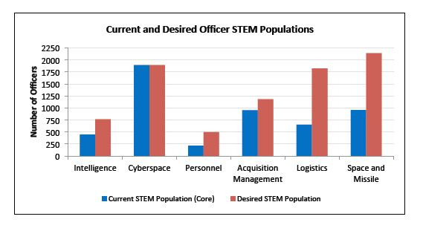
Needs of the Air force
Air Force will rely on a correspondingly larger STEM workforce in many career fields across the Air Force.⁷
Figure 2. Summary of Desired Officer STEM Population in Non-STEM Functional Areas. Courtesy of Air Force Studies Board, Examination of STEM workforce needs in the future, (The National Academies Press, 2010), 31.
Notes:
Last but not least, the Air Force heavily relies upon the modern technologies to possess compelling air, space and cyberspace capabilities. The growing complexity of both traditional and future missions will likely increase STEM degree needs.⁵ Air Force future missions will become more technologically demanding and will rely on a correspondingly larger STEM workforce in many career fields across the Air Force.⁶ It is predicted that while over 5,100 the Air Force officers with STEM degrees currently serve in some non-STEM required areas, some 3,200 more officers with STEM degrees are required to meet current needs.⁷

Slide 9
overview
Eligibility
Needs of the Air Force
Soft Skills

Slide 10
SOFT Skills
“Officers must see themselves first as military leaders and secondly as specialists such as pilots, engineers, financial comptrollers.”⁸
Notes:
The thing that separates military officers from all other professions is officership.⁸
“Officers must see themselves first as military leaders and secondly as specialists such as pilots, engineers, financial comptrollers, logisticians, air battle managers.”⁹
There are many soft skills such as integrity; charisma, inspiration, vision, effective team building, and communicating are all essential for becoming great leaders.¹⁰ None of the last four Chief of Staffs of the Air Force have a degree in STEM.¹¹⁻¹⁴
Should the Air Force recruit only officers with STEM degrees, it will turn away many great future leaders.

Slide 11
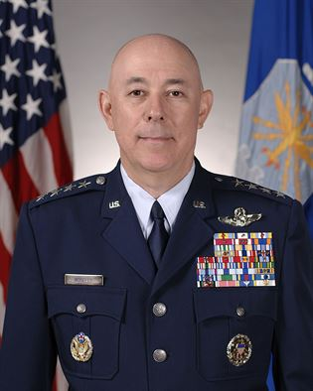
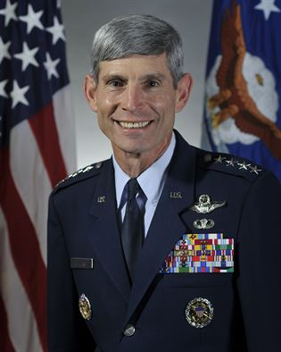
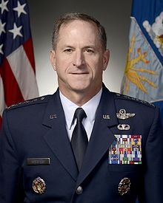
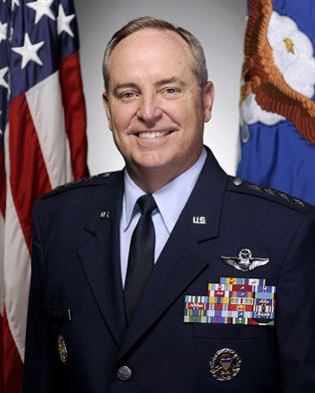
SOFT Skills
None of the recent four Chief of Staffs of the Air Force have a degree in STEM.⁹⁻¹²
Figure 3. Recent four Chief of Staffs of the Air Force. Left to right: Gen N. Schwartz,
Gen D. Goldfein, Gen T. Moseley, and Gen M. Welsh III. Photographs courtesy of www.af.mil.
Notes:
The thing that separates military officers from all other professions is officership.⁸
“Officers must see themselves first as military leaders and secondly as specialists such as pilots, engineers, financial comptrollers, logisticians, air battle managers.”⁹
There are many soft skills such as integrity; charisma, inspiration, vision, effective team building, and communicating are all essential for becoming great leaders.¹⁰ None of the last four Chief of Staffs of the Air Force have a degree in STEM.¹¹⁻¹⁴
Should the Air Force recruit only officers with STEM degrees, it will turn away many great future leaders.

Slide 12
SUMMary
Eligibility
Needs of the Air Force
Soft Skills

Slide 13
End notes
1. US Immigration and Customs Enforcement, STEM Designated Degree Program List.
2. Air Force Studies Board, Examination of the U.S. Air Force’s Science, Technology, Engineering, and Mathematics (STEM) Workforce Needs in the Future and Its Strategy to Meet Those Needs (The National Academies Press, 2010), 31.
3. Ibid.
4. Ibid.
5. Lisa M. Harrington et al., Air Force–Wide Needs for Science, Technology, Engineering, and Mathematics (STEM) Academic Degrees (Santa Monica, CA: RAND Cooperation, 2014), 3.
6. Ibid., xiii.
7. Ibid., 19.
Notes:
This concludes my briefing. Are there any questions?

Slide 14
End notes
8. Lt. Col. Gary T. McCoy, Developing Officership: It Starts At The Top (Maxwell AFB, AL: Air University, April 1996), 4.
9. General Mark A. Welsh III, http://www.af.mil/AboutUs/Biographies/Display/tabid/225/Article/104966/general-mark-a-welsh-iii.aspx.
10. General Norton A. Schwartz, http://www.af.mil/AboutUs/Biographies/Display/tabid/225/Article/104626/general-norton-a-schwartz.aspx.
11. General T. Michael Moseley, http://www.af.mil/AboutUs/Biographies/Display/tabid/225/Article/104651/general-t-michael-moseley.aspx.
12. General David L. Goldfein, http://www.af.mil/AboutUs/Biographies/Display/tabid/225/Article/108013/general-david-l-goldfein.aspx.
Notes:
This concludes my briefing. Are there any questions?

Slide 15
Questions?
Notes:
This concludes my briefing. Are there any questions?

